Slide 1





ATTENDANCE MARKING USING FACE RECOGNITION

Slide 2

About Us
OUR TEAM
DEPARTMENT
Riya George
Shifa Nazar V
Sreya K Raj
School of Digital Sciences
COLLEGE
Kerala University of Digital Sciences, Innovation and Technology
Technocity Campus, Thiruvananthapuram, Kerala, India -695317

Slide 3
Introduction
Traditional attendance tracking is labour-intensive and error-prone, necessitating a shift towards innovative, automated solutions.
Manual methods are time-consuming, prone to inaccuracies, and struggle with scalability, prompting the need for streamlined systems.
This project addresses challenges in attendance management by introducing a real-time system powered by TensorFlow Lite for object detection and facial recognition.
The project aims to provide an automated, accurate, scalable alternative for tracking attendance in educational and organisational settings.

Slide 4

Significance of the project
Efficiency and Time Savings:
Automation eliminates manual processes, saving time and enhancing overall efficiency.
Reduced Administrative Burden:
Decreases administrative workload, allowing staff to focus on more strategic tasks.
Accuracy and Fraud Prevention:
Ensures accurate attendance and reduces the risk of fraudulent practices like proxy attendance.
Real-Time Tracking:
Provides real-time attendance data, enabling swift responses to unexpected events.

Slide 5
Significance of the project
Scalability and Consistency:
Easily scalable and ensures consistent attendance management, even in large setups.
Improved Student Engagement:
Positively impacts student engagement, fostering a conducive learning environment.
Enhanced Security Measures:
Adds an extra layer of security, ensuring authorized access to attendance records.
Adaptability Across Industries:
Versatility makes it applicable not only in education but also in various industries and settings.

Slide 6

Technological Solution
Pioneering attendance system using TensorFlow Lite for real-time object detection, tailored for student attendance tracking.
Custom Model:
Python-built model ensures accurate object detection within a camera's field.
Facial Recognition:
Seamlessly integrates with automated attendance, identifying students via facial recognition.
Excel Records:
Marks students as "Present" in structured Excel, dynamically managing attendance.

Slide 7
Technological Solution
Continuous Real-Time:
Operates continuously, capturing live webcam frames, updating attendance instantly.
Graphical Precision:
Visual illustration showcases precise object detection and facial recognition in real-time.
Adaptability:
Meets real-time attendance needs in education, with potential across various contexts.

Slide 8
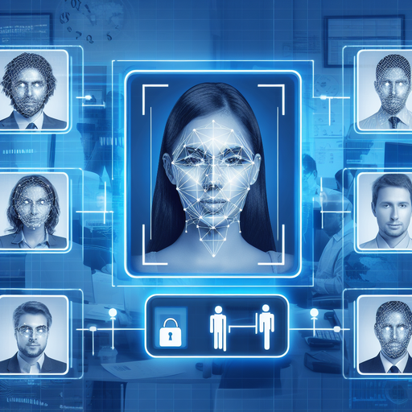
Objectives
Real - time attendance marking
Automatic Face Recognition
Efficient and secure attendance management
Implementation in institutional settings

Slide 9
Data Collection
Total of 76 facial images
10 students
Captured using mobile phones and laptop cameras
Diverse set of visuals: various angles, lighting conditions, facial expressions

Slide 10
Label Studio
TFRecords Format
Roboflow Processing
DATA PREPROCESSING
Resizing and Normalization
Augmentation Techniques

Slide 11
DATA PREPROCESSING
Label Studio
Label Studio usage for precise annotation and labeling
Accurate bounding boxes drawn around faces
Person's name as the label
Roboflow Processing

Slide 12
DATA PREPROCESSING
Roboflow Processing
Data processed through Roboflow
Platform for organization, augmentation, and preprocessing
Various augmentation techniques: rotation, flipping, scaling
Label Studio
Augmentation Techniques

Slide 13
DATA PREPROCESSING
Augmentation Techniques
Diversifying the dataset
Techniques used: rotation, flipping, scaling
Ensuring adaptability to varying real-world scenarios
Roboflow Processing
Resizing and Normalization

Slide 14
DATA PREPROCESSING
Resizing and Normalization
Additional augmentation through resizing and normalization
Uniformity and consistency in the dataset
Enhancing model's adaptability
Augmentation Techniques
TFRecords Format

Slide 15






BEFORE AFTER

Slide 16
DATA PREPROCESSING
TFRecords Format
Data downloaded in TFRecords format
Specifically tailored for TensorFlow
Efficient storage and access for optimized model performance
Resizing and Normalization

Slide 17
Methodologies
TF2 Object Detection Zoo
Introduction to the TF2 Object Detection Zoo
Collection of pre-trained object detection models
Models include SSD MobileNet V2, EfficientDet D0, and more
Configurable settings for model selection

Slide 18
Methodologies
Model Selection
Overview of chosen_model variable
Dynamic selection of a model from the TF2 Object Detection Zoo
Customizable configurations for specific model requirements

Slide 19
Methodologies
Model Selection
SSD MobileNet V2
EfficientDet D0
SSD MobileNetV2 FPNLite 320
Overview of SSD MobileNet V2 architecture
Introduction to EfficientDet architecture
Combination of Single Shot Multibox Detector (SSD) and MobileNetV2
Combination of SSD algorithm and MobileNetV2
Focus on balancing accuracy and efficiency
Efficient real-time object detection
Real-time object detection with efficient processing
"d0" denotes a specific scale level
Input size optimized at 320x320 pixels
Lightweight convolutional neural network
Computational efficiency with varying scale levels
Utilizes Feature Pyramid Network Lite (FPNLite)

Slide 20
Methodologies
File setup
Creation of "mymodel" directory in google drive.
Retrieval and extraction of pre-trained weights
Acquisition of training configuration file
Establishing structured file management for the model

Slide 21
Methodologies
Training Parameters
Setting number of training steps (40,000)
Determining batch size based on chosen_model
Impact of batch size on training efficiency
Essential for customizing training process

Slide 22
Methodologies
Custom Configuration
Dynamic generation of custom configuration file
Adjustments for fine-tune checkpoint and dataset paths
Model-specific modifications for optimization
Customization for 'ssd-mobilenet-v2' and 'efficientdet-d0'

Slide 23
Methodologies
Training Execution
Initiating training process with model_main_tf2.py
script is directed towards the custom configuration file, 'pipeline_file.config’
Utilizing custom configuration file and model directory
Real-time monitoring with 'alsologtostderr'
Determining total number of training steps

Slide 24
Methodologies
TFLite Model Conversion
Using TFLiteConverter for model conversion
Saving the converted model as 'detect.tflite'
Essential step for deployment on resource-constrained devices
Creating metadata for TensorFlow Lite object detection model and saving the model as ‘detect_metadata.tflite’

Slide 25
Results
Code Structure
Overview of the Python code structure for running a custom TFLite model on test images.
Importing essential libraries such as OpenCV, NumPy, and TensorFlow Lite.
Focus on the tflite_detect_images function, handling model inference on test images.

Slide 26
Results
Test Image Inference
Execution of the code for model inference on selected test images.
Utilization of TensorFlow Lite interpreter for object detection.
Annotation of bounding boxes, object labels, and confidence scores on test images.
Visual verification of the model's performance in detecting objects.

Slide 27
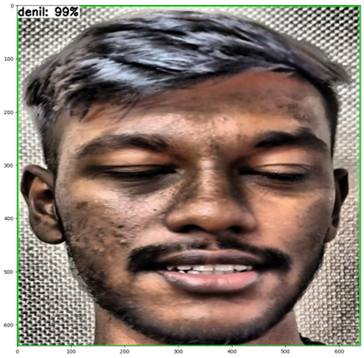
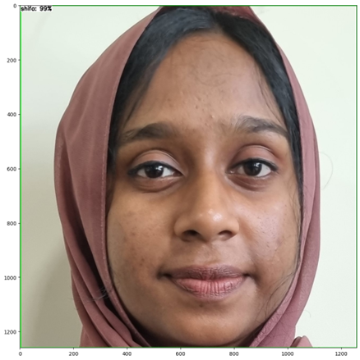
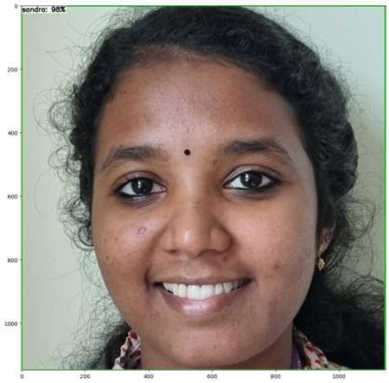
Results
Test Image Inference

Slide 28
Results
Real-time Object Recognition
Application of TensorFlow Lite for real-time object recognition.
Introduction of the tflite_detect_webcam function for webcam-based object detection.
Usage of Haar Cascade classifier for face recognition in webcam frames.
Preprocessing and resizing of face regions to match model input size.

Slide 29
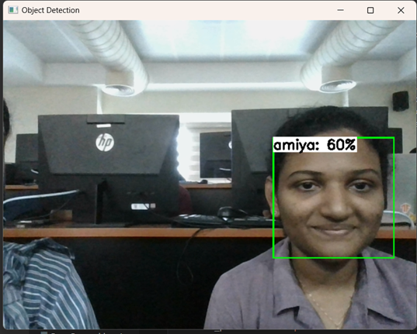
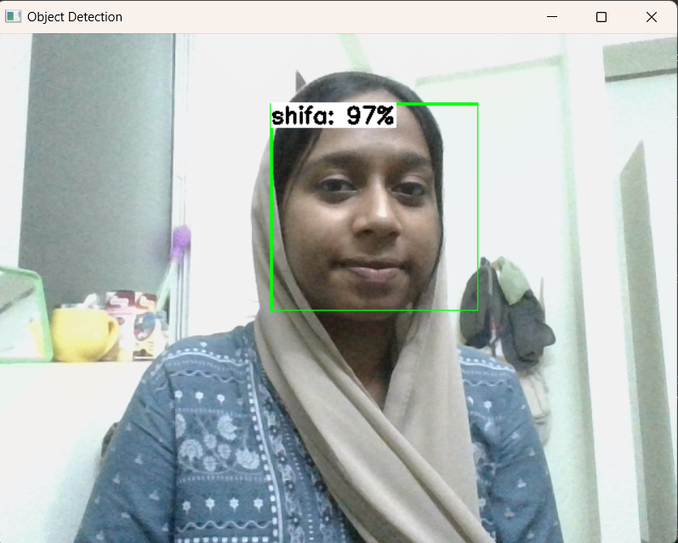
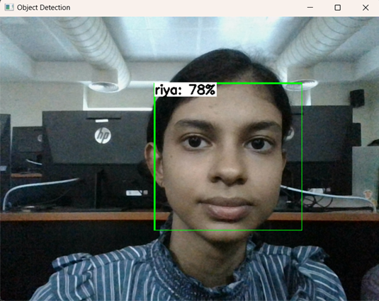
Results
Real-time Object Recognition

Slide 30
Results
Attendance Integration
Integration of attendance tracking into real-time object recognition.
Description of the tflite_detect_webcam function updating attendance for recognized faces.
Management of attendance data using an Excel file called "students.xlsx."
Continuous running of the code for real-time attendance tracking.

Slide 31
Results
Real-time Results
Presentation of real-time object detection results.
Display of detected objects, labels (names of people), and accuracy of predictions.
Figure showcasing the outcomes of object detection with labels and accuracy percentages.

Slide 32
Future Scopes
Enhanced Feature Set:
Expand capabilities with additional features like voice recognition or multi-modal biometrics for increased security.
Mobile Application Integration:
Develop a mobile app for convenient monitoring, notifications, and settings management on the go.
Machine Learning Refinement:
Continuously improve object detection and facial recognition through machine learning model refinement.
Integration with Learning Management Systems (LMS):
Explore integration with existing LMS to streamline data exchange and enhance educational ecosystems.

Slide 33
Future Scopes
Security and Privacy Enhancements:
Implement advanced security measures, including encryption and secure data storage, addressing privacy concerns.
Adaptation to Various Settings:
Modify the system for diverse environments beyond education, broadening its applicability.
IoT Integration:
Explore integration with IoT devices for enhanced connectivity, potentially incorporating smart sensors.
User Customization Options:
Provide customization options, allowing users to tailor the system to their specific needs and preferences.
Feedback Mechanism Implementation:
Integrate a feedback mechanism for continuous improvement based on user experiences and requirements.

Slide 34
Conclusion
- The automated attendance system using TensorFlow Lite represents a significant advance in accurate management, showcasing the transformative potential of machine learning and computer vision.
- Integrating real-time object detection and facial recognition, it streamlines attendance tracking, reducing manual efforts and errors.
- Its dynamic ability to update records in Excel exemplifies practicality and adaptability.
- Beyond attendance, the project demonstrates technology's impact in simplifying tasks and enhancing efficiency.

Slide 35
References
1. | Kar, N., Debbarma, M. K., Saha, A., & Pal, D. R. (2012). Study of implementing automated attendance system using face recognition technique. International Journal of computer and communication engineering, 1(2), 100-103.
2. | Lukas, S., Mitra, A. R., Desanti, R. I., & Krisnadi, D. (2016, October). Student attendance system in classroom using face recognition technique. In 2016 International Conference on Information and Communication Technology Convergence (ICTC) (pp. 1032-1035). IEEE.
3. | Sawhney, S., Kacker, K., Jain, S., Singh, S. N., & Garg, R. (2019, January). Real-time smart attendance system using face recognition techniques. In 2019 9th international conference on cloud computing, data science & engineering (Confluence) (pp. 522-525). IEEE.
4. | Jadhav, A., Jadhav, A., Ladhe, T., & Yeolekar, K. (2017). Automated attendance system using face recognition. International Research Journal of Engineering and Technology (IRJET), 4(1), 1467-1471.
5. | Patil, A., & Shukla, M. (2014). Implementation of classroom attendance system based on face recognition in class. International Journal of Advances in Engineering & Technology, 7(3), 974.

Slide 36

QUESTIONS

Slide 37
Thank You…

